Slide 1
General Purpose Registers of 8086

Slide 2
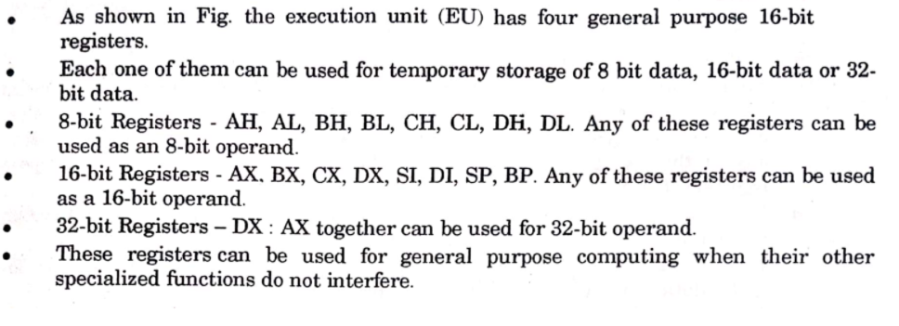
General Purpose Registers of 8086

Slide 3
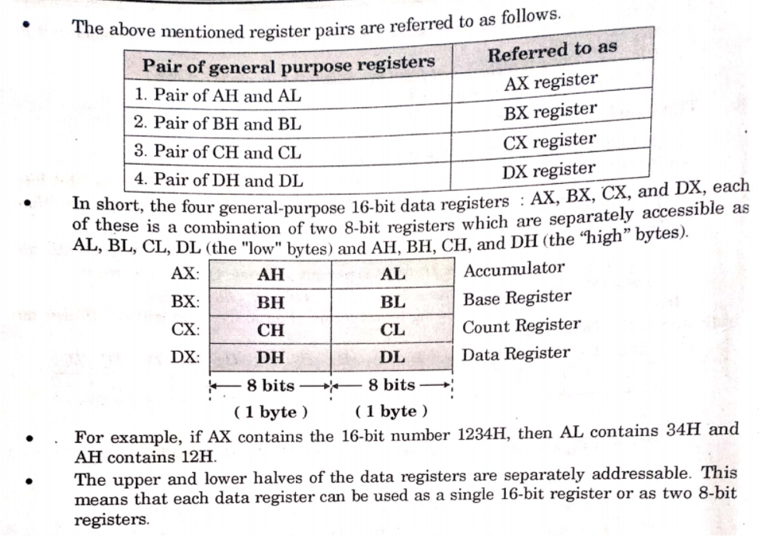

Slide 4
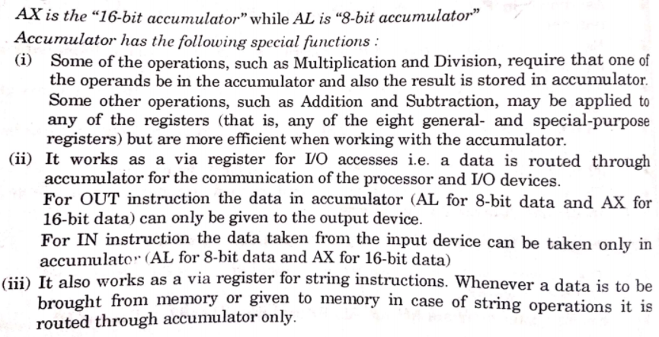
Special functions of general purpose registers of 8086
1. Register AX :
Accumulator

Slide 5
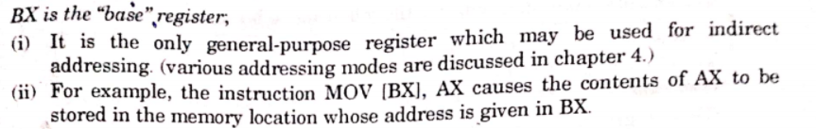
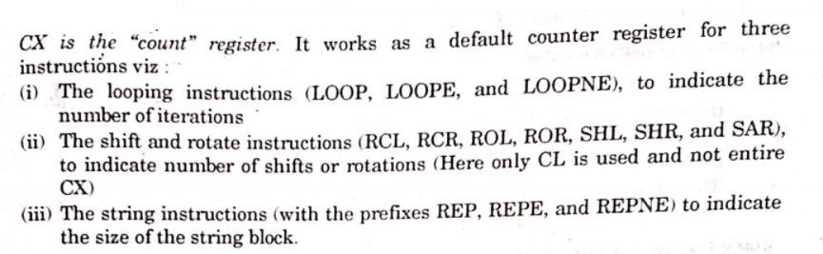
2. Register BX :
Base
3. Register CX :
Counter

Slide 6
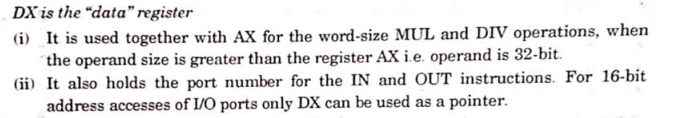
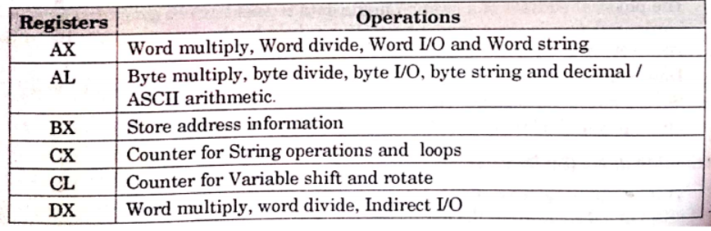
4. Register DX :
Data

